Slide 1
Treasury Bills
Treasury Notes
Treasury Bonds
Maturity--less than a year
Maturity--one to ten years
Maturity--more than ten years

Slide 2
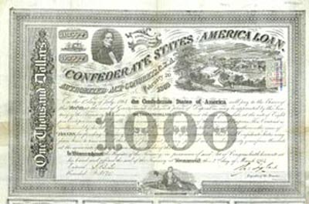
Treasury Bill

Slide 3
Treasury Note—more than 1 year and
up to 10 years.

Slide 4
Treasury
Bond—
more than
10 years and
up to 30 years.

